Slide 1


Celestial Navigation through Zenith-Image Analysis
Austin Kreulach
University of Arkansas
Department of Computer Science and
Computer Engineering
Harrison Welch
Austin Peay State University
Department of Computer Science and
Information Technology

Slide 2
Presentation Structure
Overview and Background
Our Tools
Proposed Method
Results
Conclusions
Potential for Future Researchers
Notes:
Contains: What exactly we plan to speak about

Slide 3

Overview and Background
GPS-denied Homing for UAVs
Transition to greater problem
Notes:
Contains: What exactly we plan to speak about

Slide 4
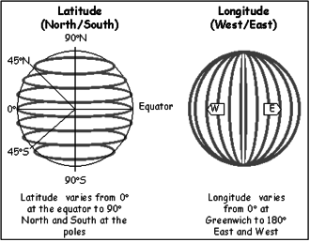
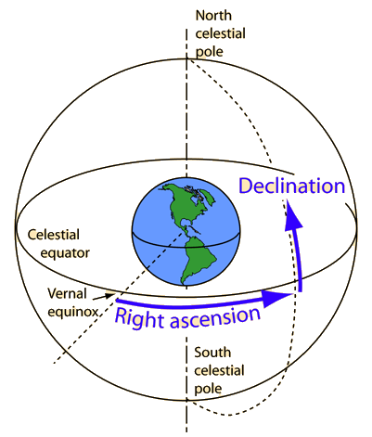
Overview of Celestial Navigation
http://blog.nameastarlive.com/wp-content/uploads/ra-dec_illustration_wp.jpg
https://web.archive.org/web/20140813074310/http://www.fedstats.gov/kids/mapstats/concepts_latlg.html

Slide 5
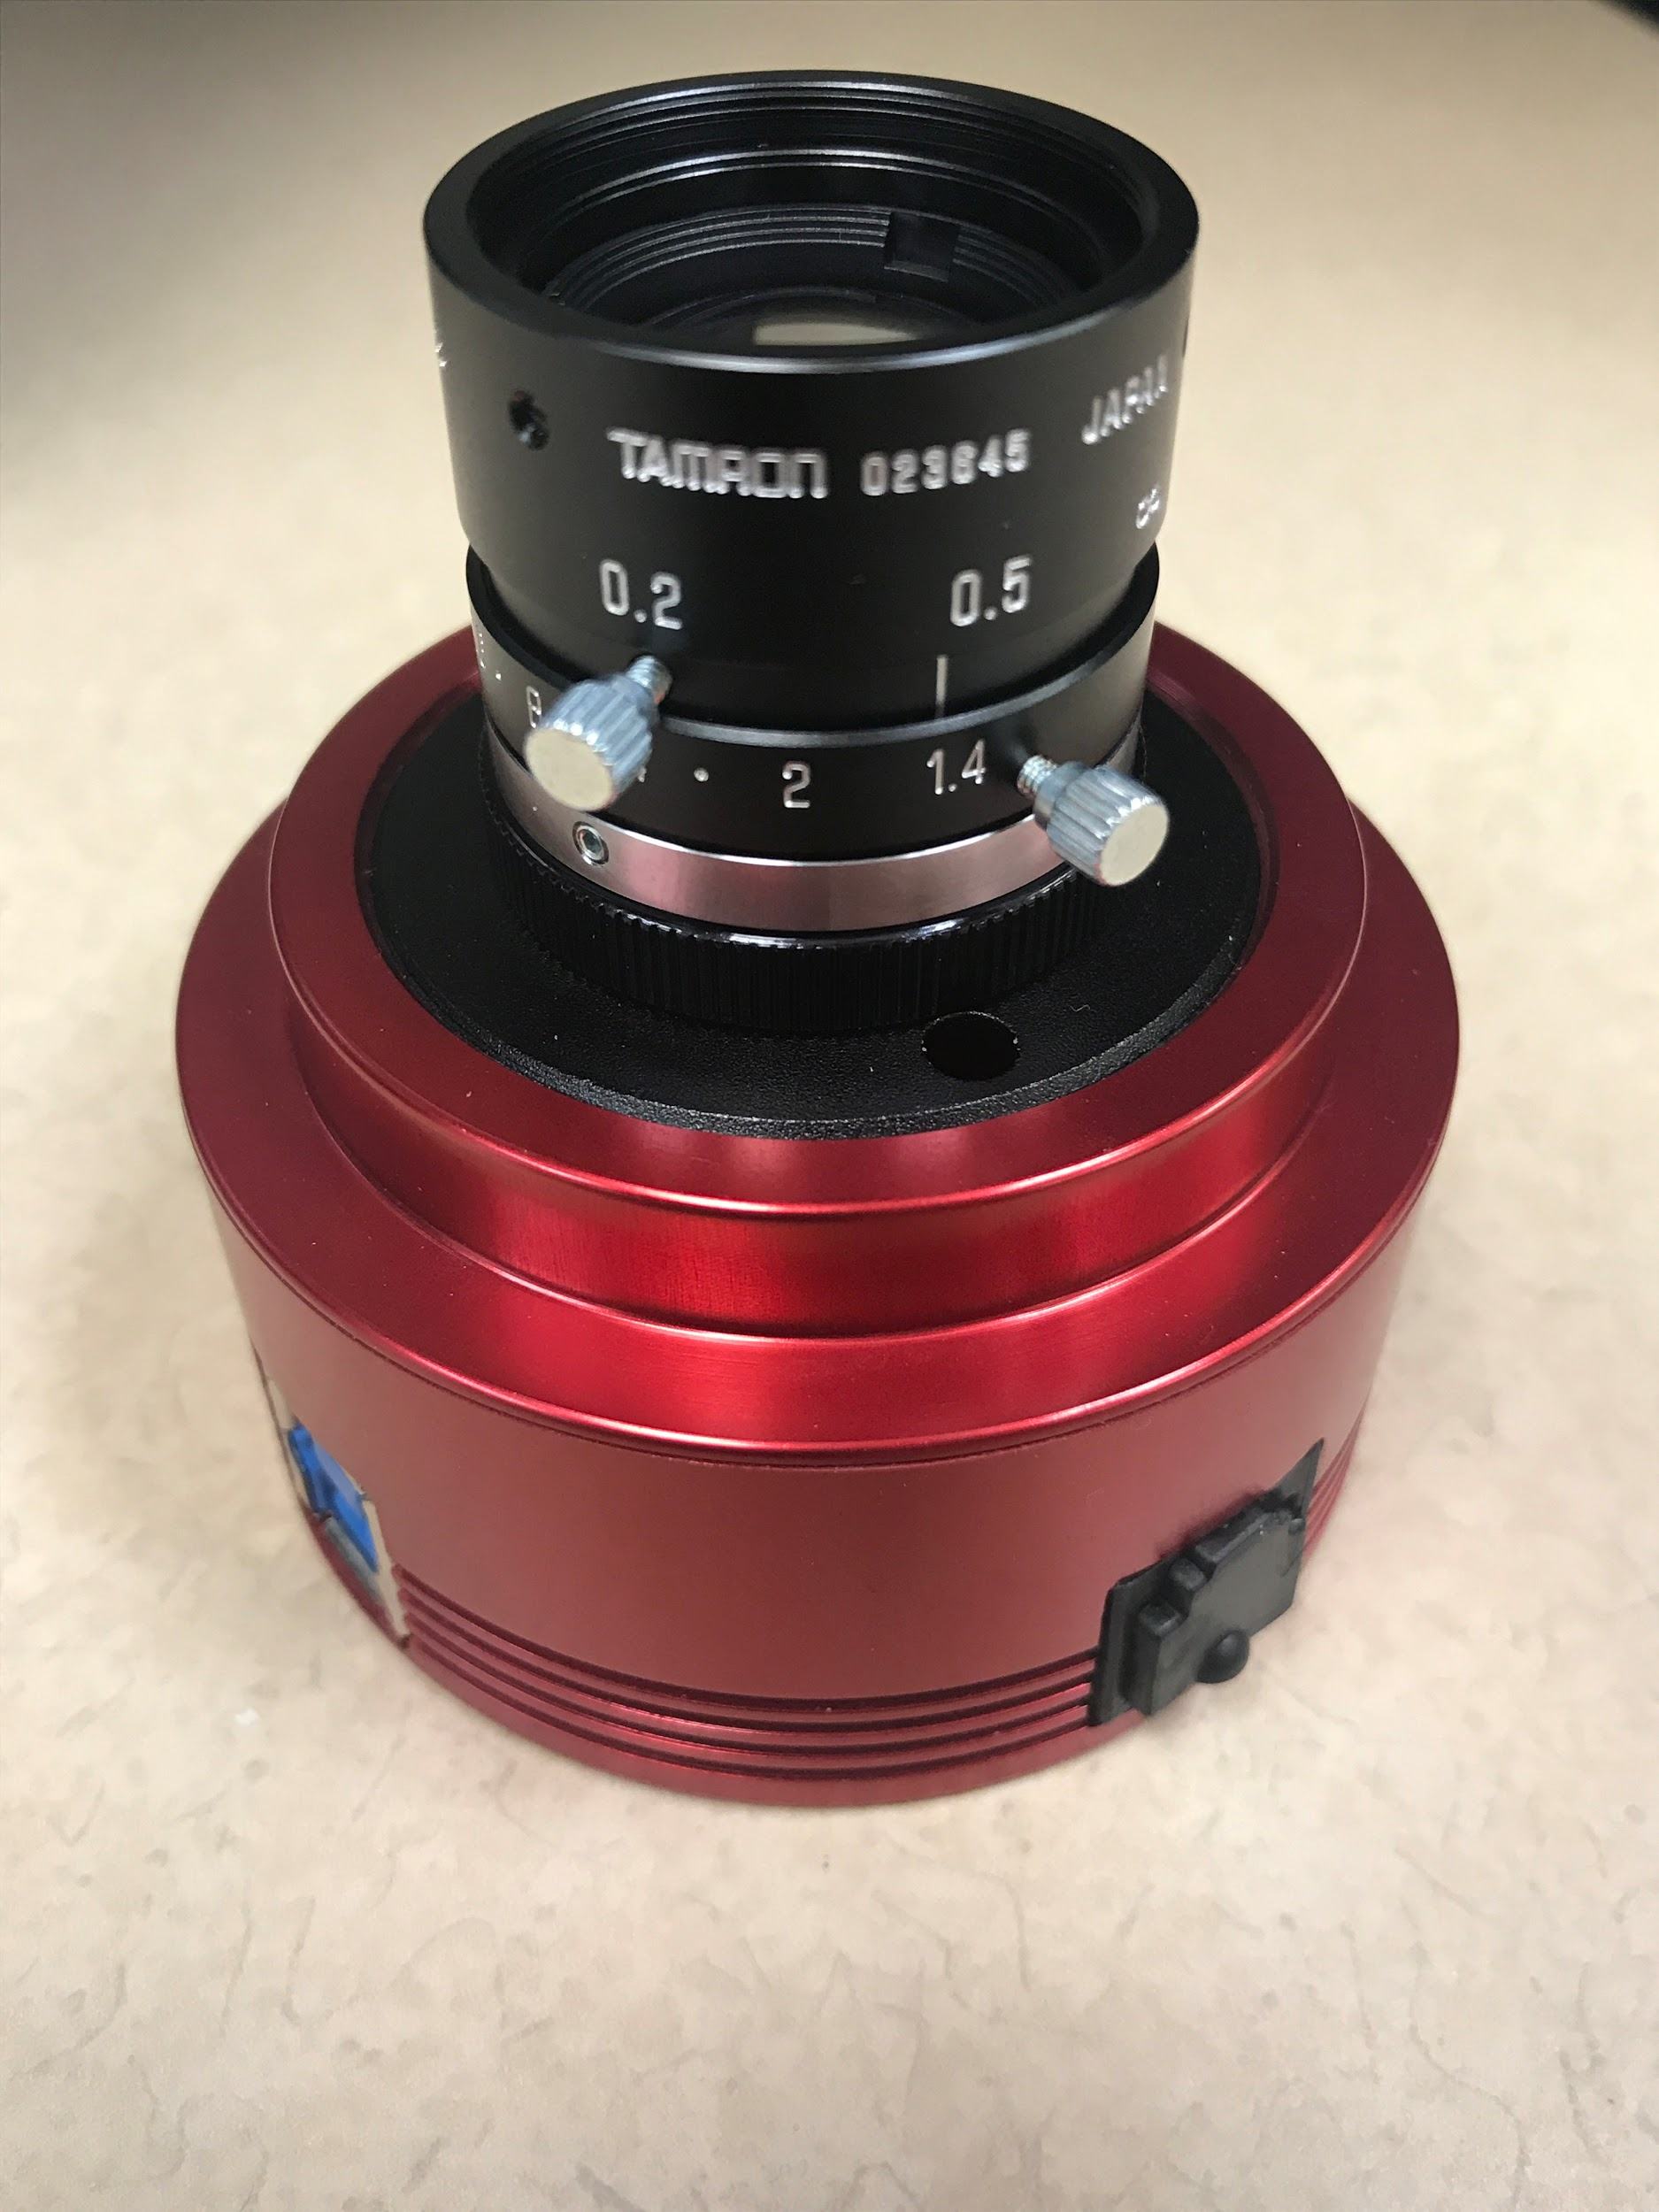
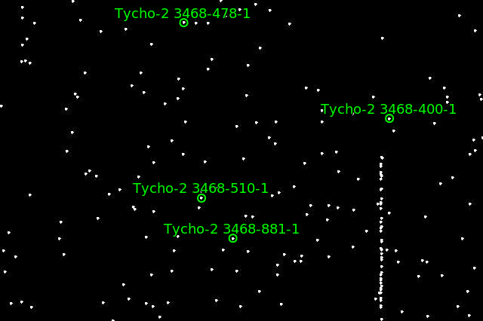

Our Tools
ZWO Camera
Astrometry.net
Stellarium
Capture from Astrometry.net’s Gallery
Notes:
Contains: What exactly we plan to speak about

Slide 6
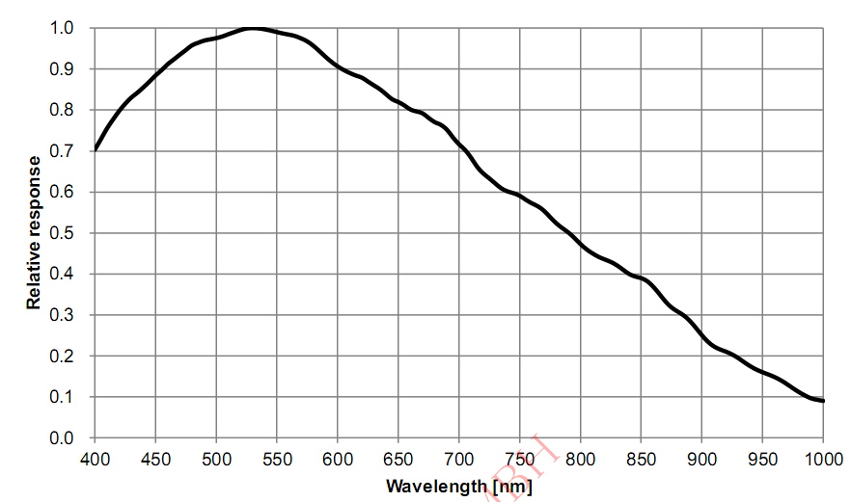
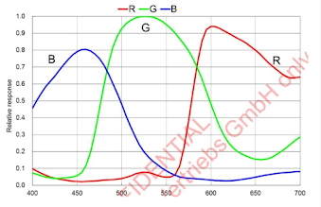
ZWO Camera and Lens
Mono
Monochrome
6.4 Megapixel
Max Res: 3096*2080
Read noise: 2.2e - 1.4e
16mm focal length lens
25.9° x 19.5°
Color
https://astronomy-imaging-camera.com/product/asi178mm-mono

Slide 7
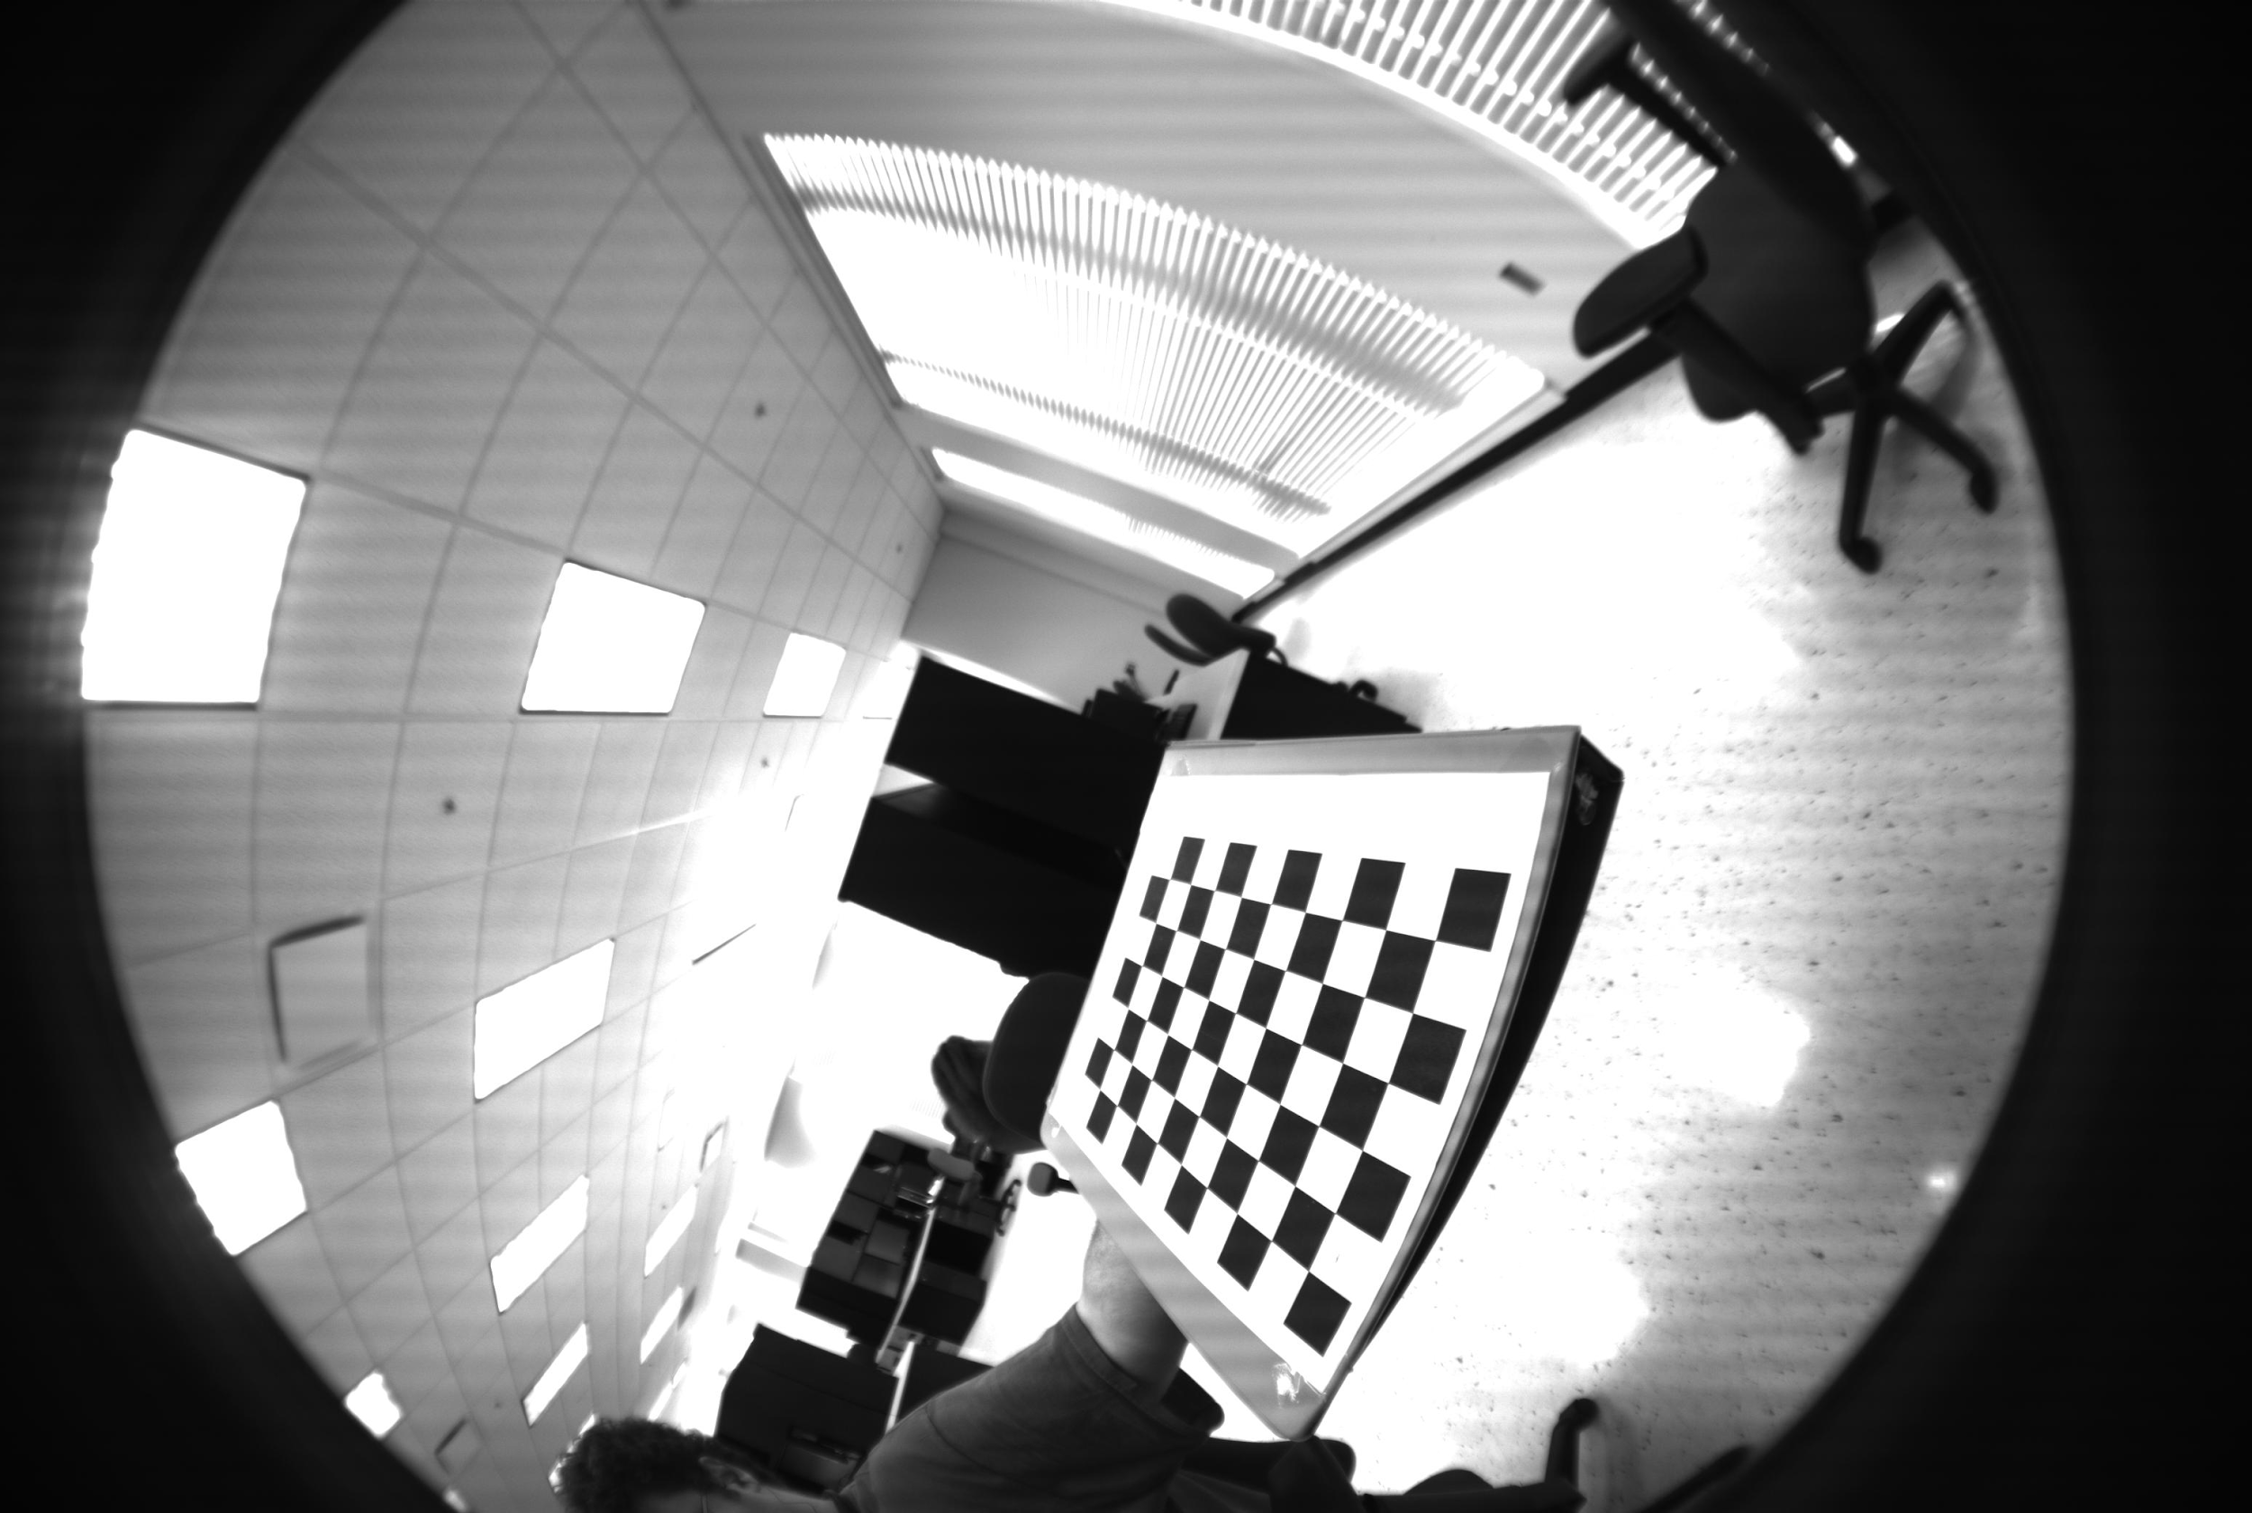
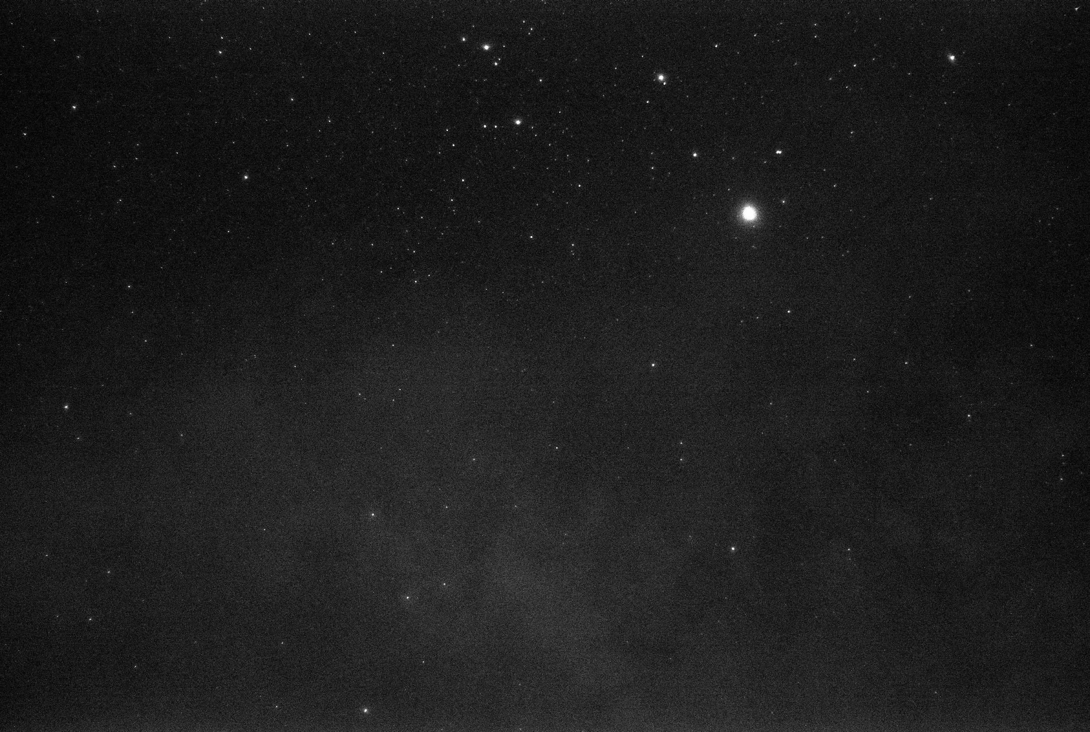
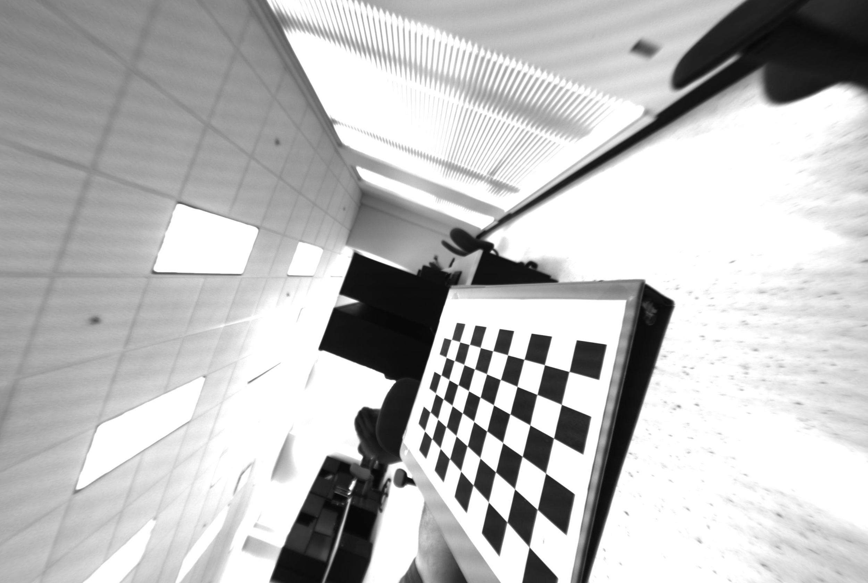
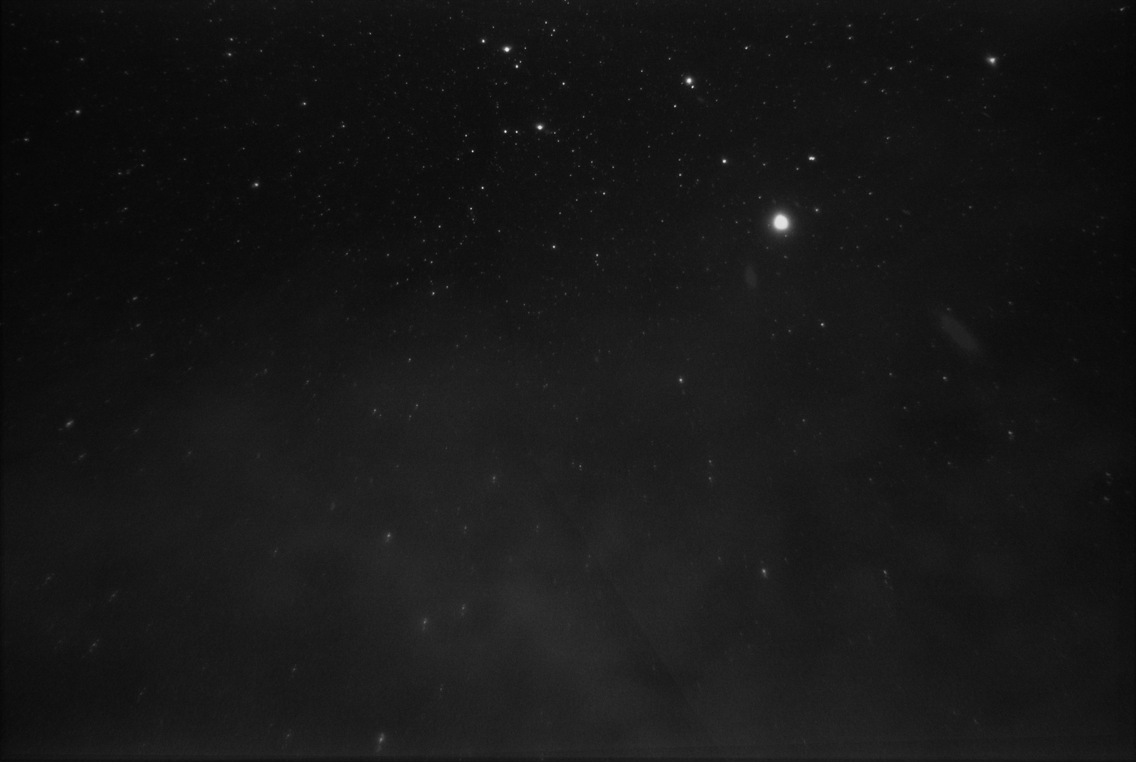
Image Modification
Defishing
Image Stacking

Slide 8
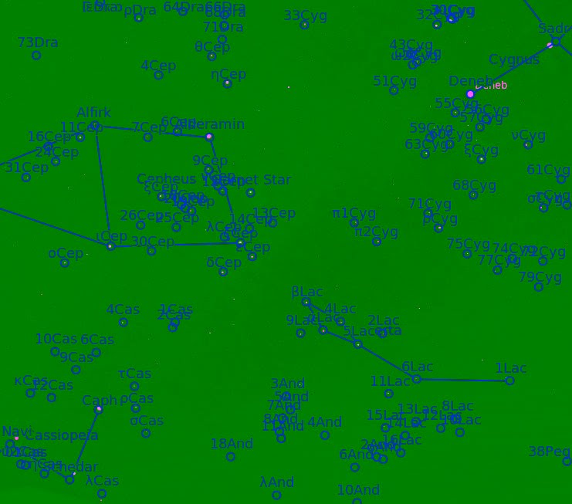
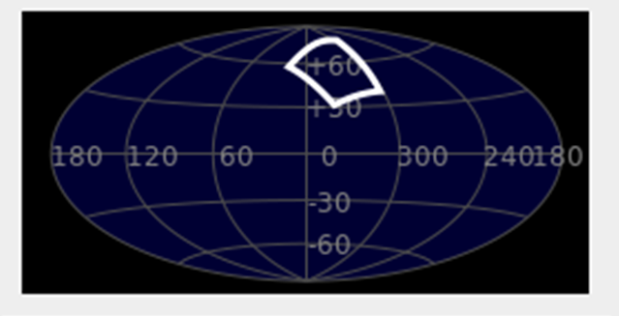
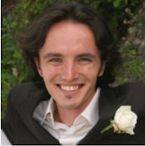
Astrometry.net
The algorithm relies on FITS files divided into HEALpix tiles
Tycho-2 and 2-MASS surveys
Builds “quads” which are groupings of 4 stars
2 most distant points forming an axis
2 remaining star locations about that axis are hashed and stored in a database
Bayesian decision of passing as a viable “quad”
Expectation of at least 1 million hashes for the entire night sky
Outputs RA and DEC of the input image
Dustin Lang, David W. Hogg, Keir Mierle, Michael Blanton, Sam Roweis. “Astrometry.net: Blind astrometric calibration of arbitrary astronomical images.” 2009. Accessed June 14, 2018. https://arxiv.org/pdf/0910.2233.pdf
Screenshot from Sellarium uploaded into nova.astrometry.net

Slide 9
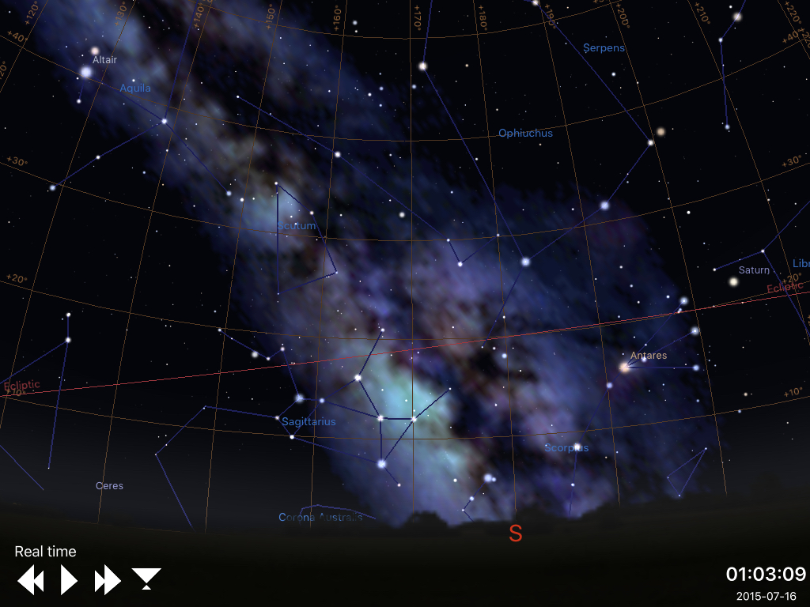
Stellarium
Astronomy simulation software used as a testbed to easily produce data en masse for analysis.

Slide 10
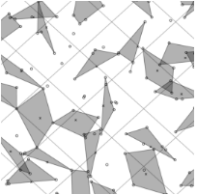
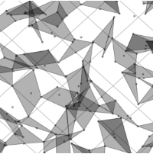
Proposed Method
Collect images and record UTC time
Analyze with Astrometry.net
Determine latitude and longitude using RA, declination, and GAST
Notes:
Contains: What exactly we plan to speak about

Slide 11
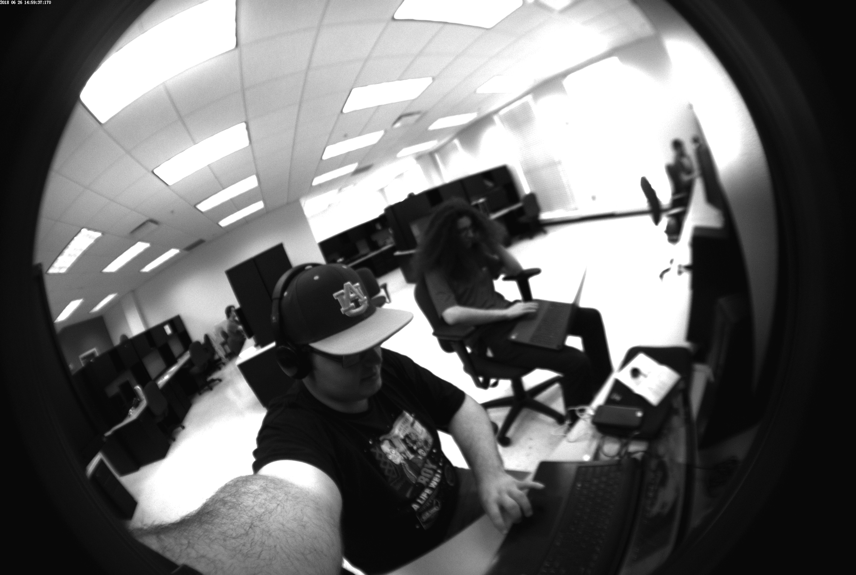
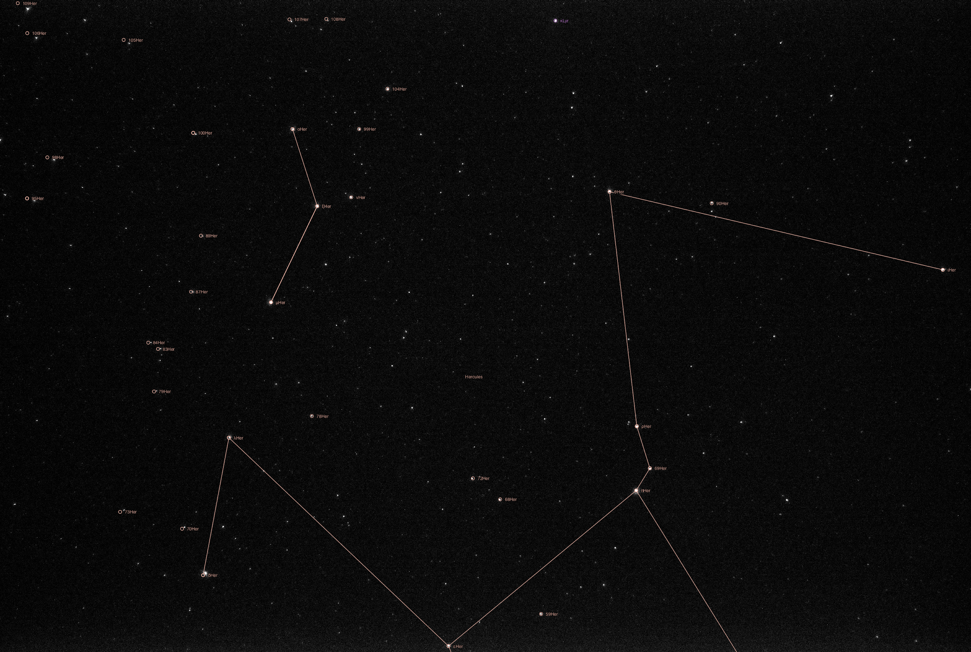
ZWO Camera Test Images
170° Fisheye
26.2183° by 17.8014° Rectilinear
ZWO ASI178MM - Monochrome, 6.4 Megapixel, 3096*2080

Slide 12
Interpreting Declination
Declination is angle above celestial equator
Celestial equator shares a plane with earthly equator
Latitude is angle above equator
Declination at zenith = latitude
http://blog.nameastarlive.com/wp-content/uploads/ra-dec_illustration_wp.jpg

Slide 13
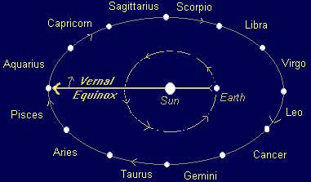
Interpreting Right Ascension
Longitude is angle between Greenwich and observer’s meridian
Right ascension is angle between vernal equinox and observer’s meridian
GAST is time, converted to degrees, between vernal equinox and Greenwich meridian
https://www.satyacenter.com/media/wysiwyg/legacy_article_images/article_904_2.jpg

Slide 14

Finding GAST
Value entirely dependent on UTC
Conversion performed using algorithm adopted from USNO
Conversion dependent on:
Julian date
Nutation in longitude
Longitude of ascending lunar node
Mean solar longitude
Obliquity
https://www.usno.navy.mil/USNO

Slide 15
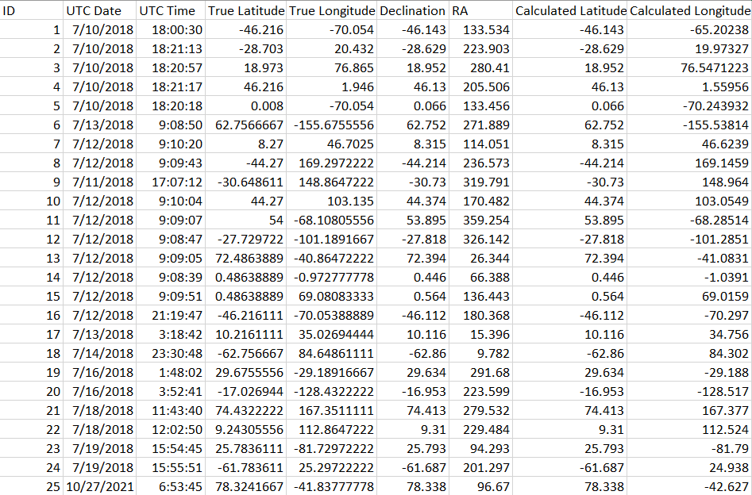
Results
Notes:
Contains: What exactly we plan to speak about

Slide 16
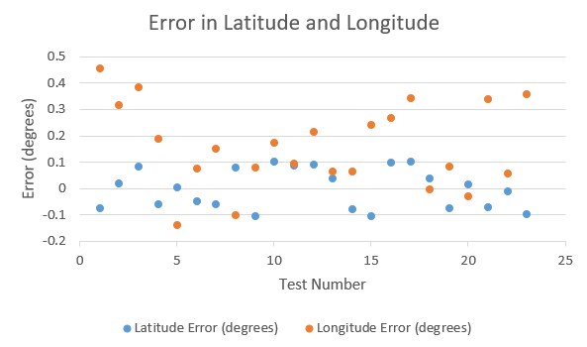
Average Error
Note latitude averages to zero
Longitude does not, indicating bias
Average error for longitude is vastly larger than for latitude
 | Mean Value | Absolute Mean Value | Mile Error
Latitude Error | ~0 | .06735 | 4.65
Longitude Error | .16207 | .18500 | 12.8

Slide 17
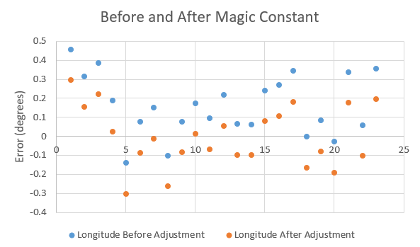
Magic Constant
Adjusting for magic constant reduces error
Undertested outside sample set
 | Mean Value | Error(miles)
Before | .16207 | 12.8
After | 0 | 9.16

Slide 18
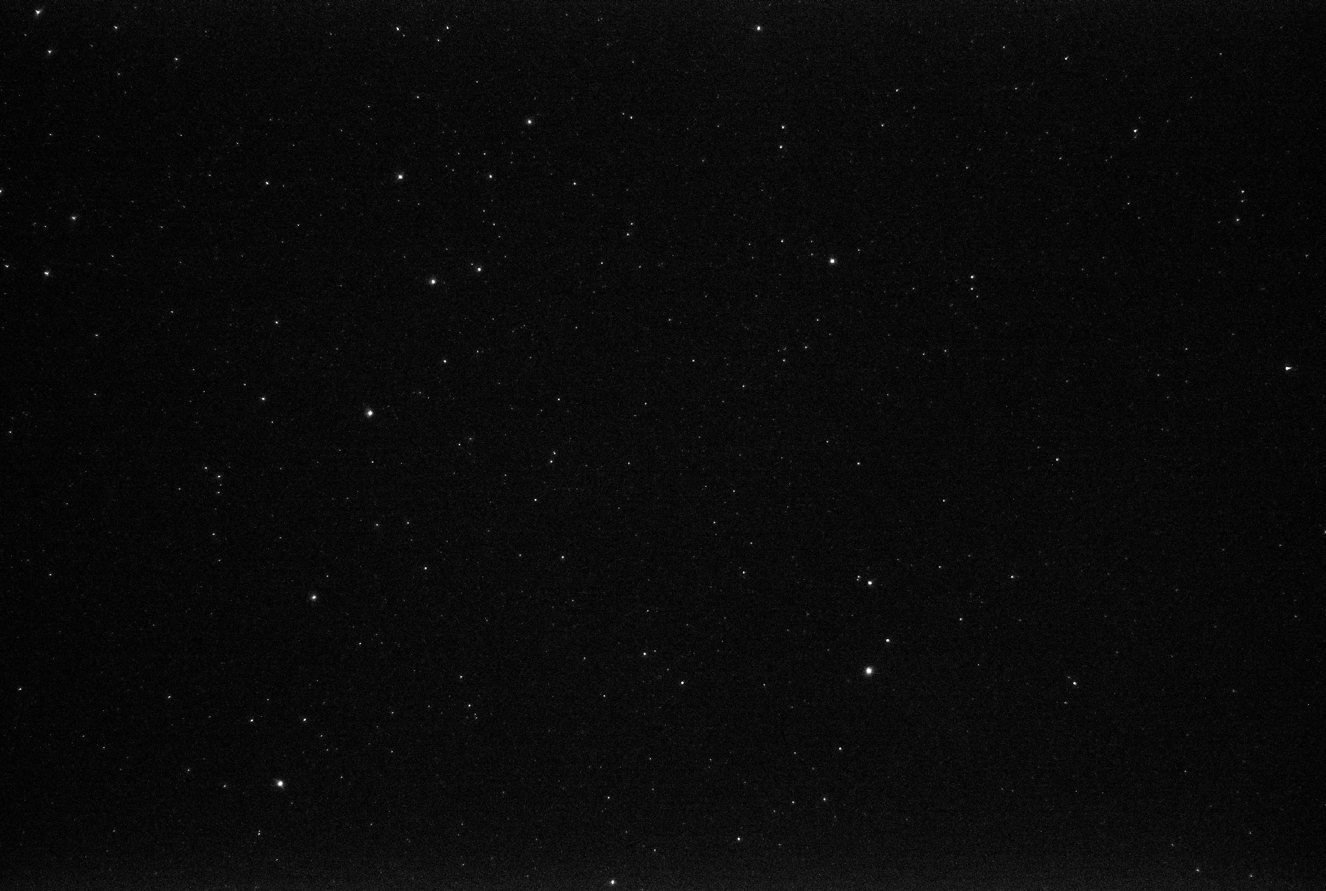
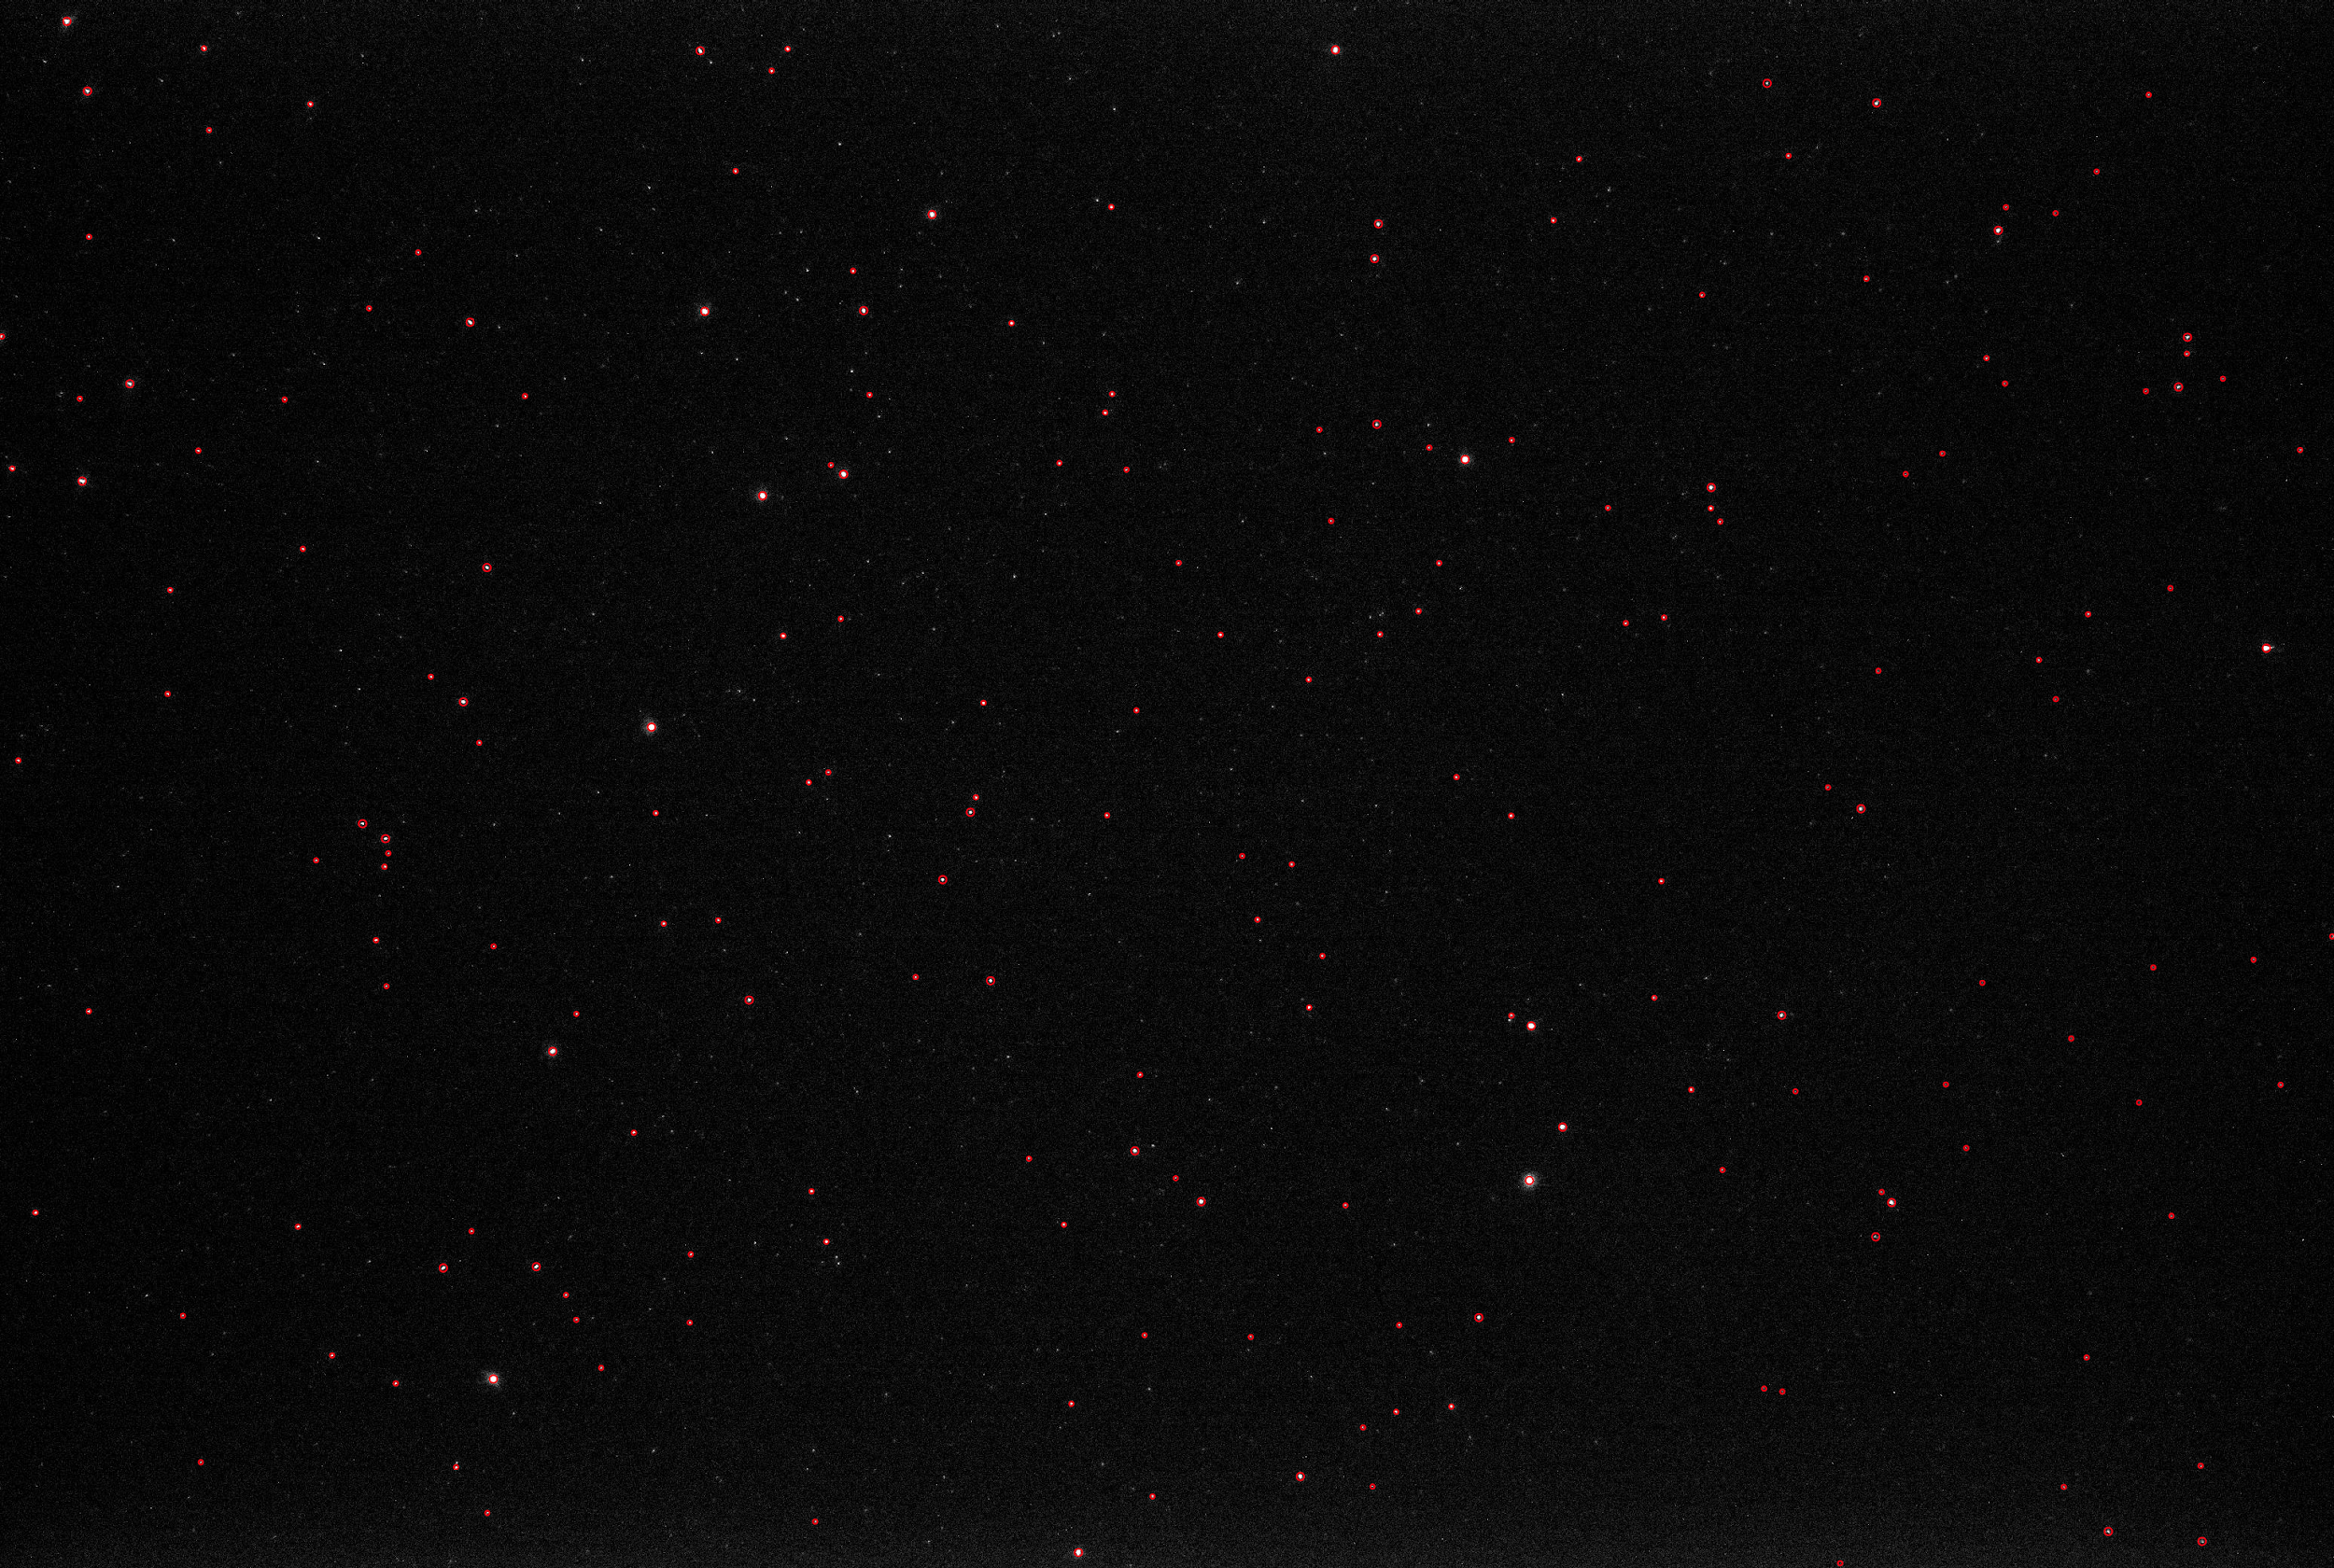
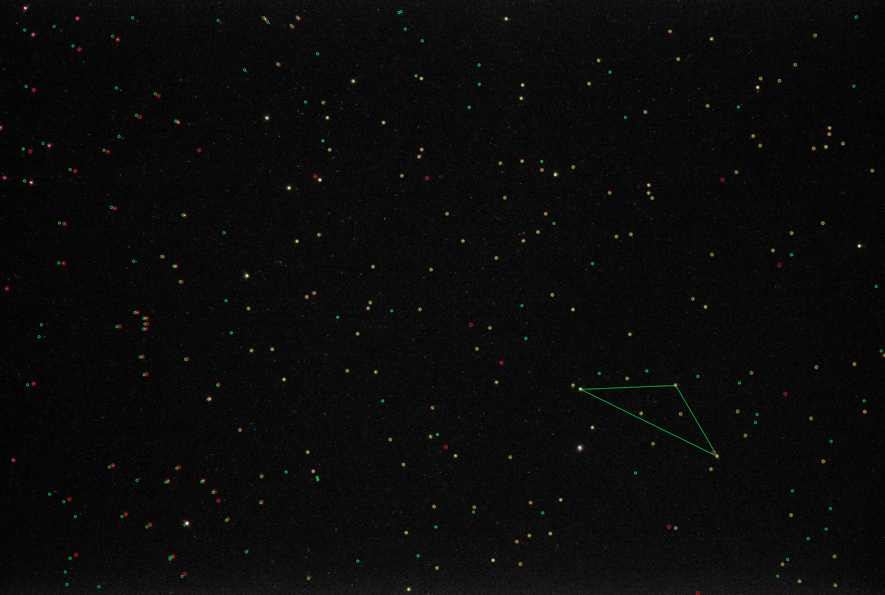
Field Experiment

Slide 19
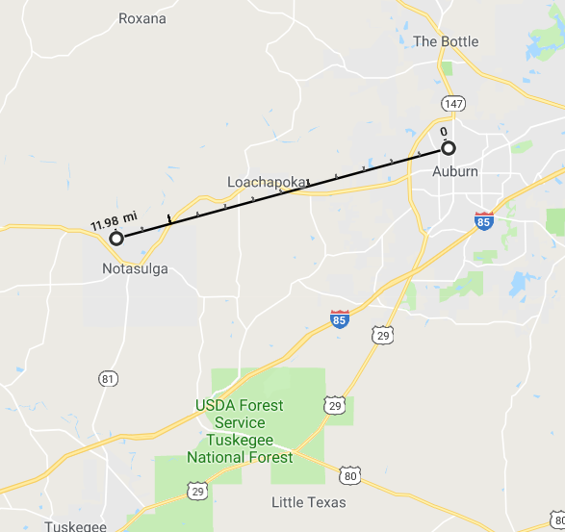
Conclusions
System able to determine position to within twelve mile radius
Method too imprecise for primary navigation, but suitable for supporting INS
Potential explanations of bias
Stellarium
Astrometry.net
Notes:
Contains: What exactly we plan to speak about

Slide 20
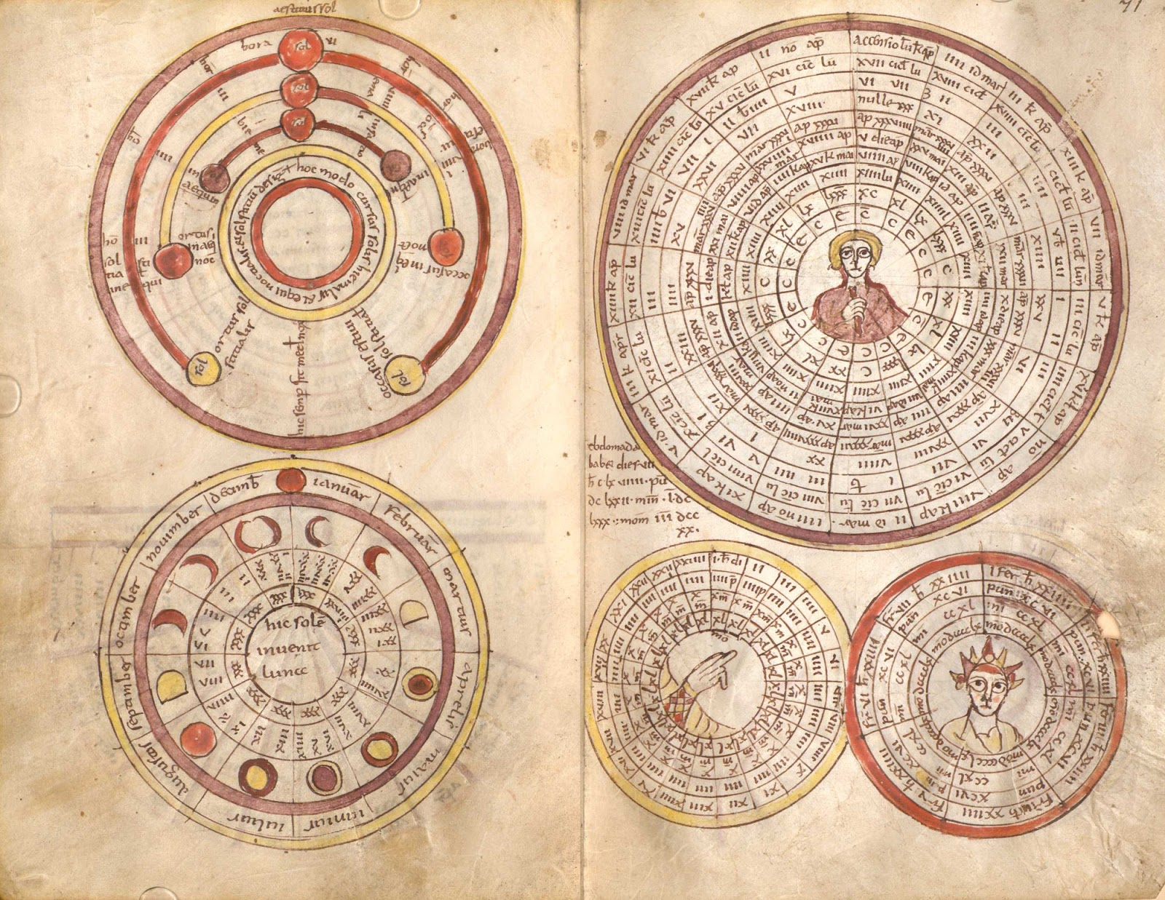
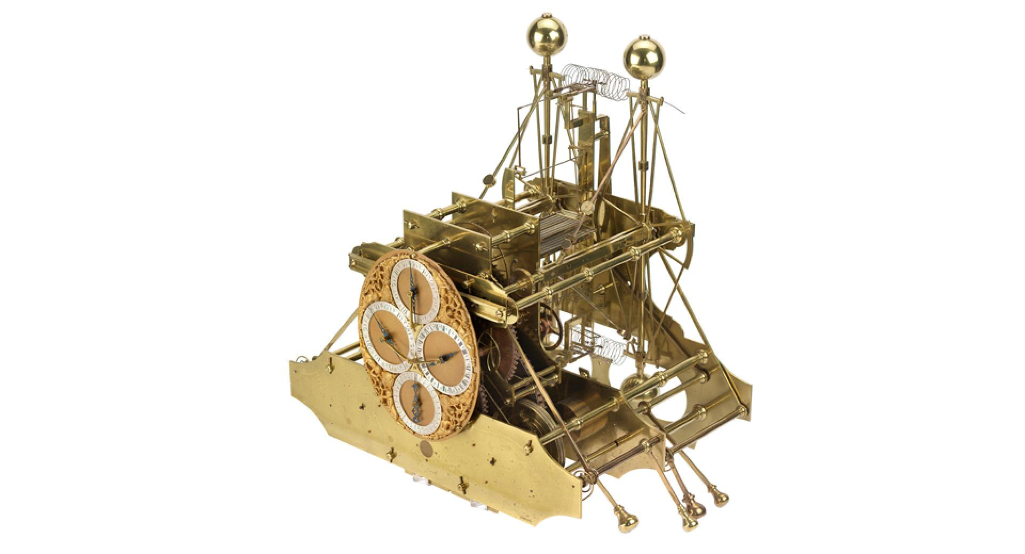
Latitude and Longitude
Latitude error: 4.56
Longitude error: between 12.8 and 9.16
http://unusualhistoricals.blogspot.com/2016/07/
https://www.rmg.co.uk/sites/default/files/styles/rmg_landscape_medium/public/Harrison%20H1%20blog.jpg?itok=_BWd6c3w

Slide 21
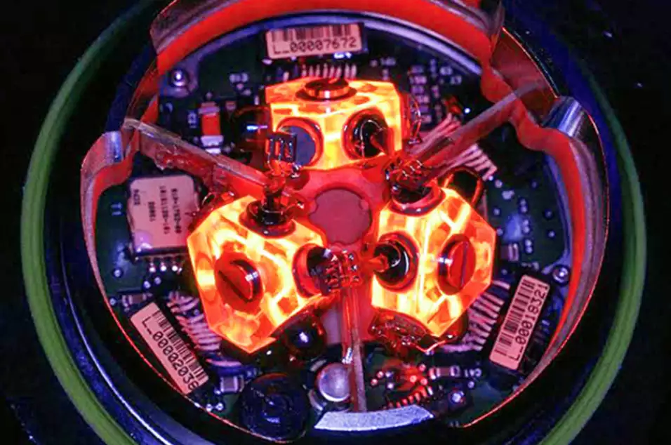
Potential for Future Researchers
Combine with INS
Filtering
Find the magic constant
Testing outside Stellarium
Simulated or field
Observatory
Star trail analysis
Optical flow
https://i.kinja-img.com/gawker-media/image/upload/s--qpmp73Ax--/c_fit,f_auto,fl_progressive,q_80,w_636/girka2ijae6givozeqld.jpg
Notes:
Contains: What exactly we plan to speak about

Slide 22
Review
Overview of Celestial Navigation
Our Tools
Proposed Method
Results
Conclusion
Potential for Future Researchers

